Slide 1


TESTING TECHNIQUES
Owned by: Presented by:
JTG Company Confidential
Notes:
‹#›
www.joshtechnologygroup.com
Presentation Title | JTG

Slide 2

Index
Boundary Value Analysis(BVA)
Equivalent Class Partition(EQP)
State transition
Decision tables
Use case(s)
JTG Company Confidential

Slide 3
Testing Techniques - Introduction
The methodologies of testing a software to find bugs/defects are called testing techniques.
Help the QA design better test cases.
Reduces the number of test cases to be executed while increasing test coverage.
Identify test conditions that are otherwise difficult to recognize.
Ensures the overall quality of the product or software.
JTG Company Confidential

Slide 4
Boundary Value Analysis
It is a black-box testing technique.
The behavior of the application is analyzed with test data residing at the boundary values of the equivalence classes.
There is a higher chance of finding errors in the software application using this method.
Example- An application that accepts a numeric number as input with a value between 10 to 100. While testing such application, we will not only test it with values from 10 to 100 but also with other sets of values like – less than 10, greater 10, special characters, alphanumeric, etc.
JTG Company Confidential

Slide 5
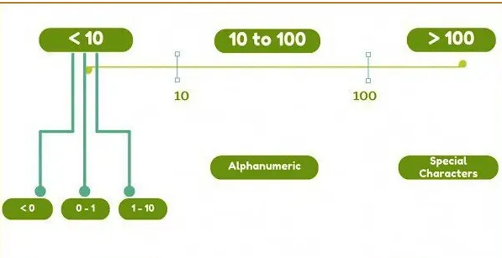
Boundary Value Analysis
Minimum value(10): The least value used to perform testing.
Just above minimum(11): Value just greater than the minimum value.
Nominal Value(10-100): Any value lying between the boundary range.
Max Value(100): The highest value used to perform testing.
Just below max value(99): Value just smaller than the maximum value used.
JTG Company Confidential

Slide 6
Boundary Value Analysis
Advantages of BVL:
Easier and Faster: The density of defects at boundaries is more.
Reduced test execution time: Only pick the value at the boundaries instead of all from the set.
Disadvantaged of BVL:
Incorrect identification of value analysis leads to incorrect boundary value testing.
Applications with open boundaries are not suitable for this technique.
JTG Company Confidential

Slide 7
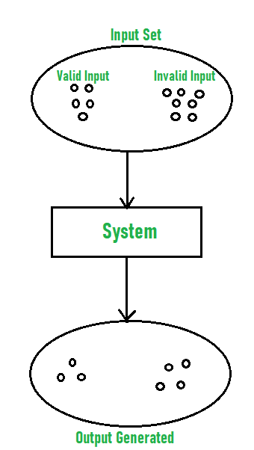
Equivalent Class Partitioning (ECP)
Also called Equivalent Partitioning Method, abbreviated as EQP.
A black-box testing technique that divides input domain into classes of data.
With the help of these classes of data, test cases can be derived.
Whenever any input is given and type of input condition is checked then for this input conditions, Equivalence class represents or describes set of valid or invalid states.
Requirement of this model is that there are infinite number of inputs from the user.
JTG Company Confidential

Slide 8
Equivalent Class Partitioning
Example of Equivalent Class Partitioning
Scenario: Testing an online form that accepts age as input. The valid age range is 18 to 60.
Identify input conditions:
Valid range: 18 to 60 (inclusive).
Invalid ranges: Below 18 and above 60.
Divide inputs into equivalence classes:
Valid Equivalence Class: Ages from 18 to 60.
Invalid Equivalence Classes:
Below 18 (e.g., 0 to 17).
Above 60 (e.g., 61 and above).
Select test cases from each class:
Test Case 1 (Valid): Input age = 30 (within the valid range).
Test Case 2 (Invalid): Input age = 15 (below the valid range).
Test Case 3 (Invalid): Input age = 65 (above the valid range).
JTG Company Confidential

Slide 9
Equivalent Class Partitioning
Expected Results:
Test Case 1: Accepted as a valid input.
Test Case 2: Rejected with an error (age is too low).
Test Case 3: Rejected with an error (age is too high).
Conclusion: ECP ensures that test cases cover representative values from both valid and invalid classes, reducing redundant tests while covering all scenarios.
JTG Company Confidential

Slide 10
State Transition Model
Definition: A state transition model represents how a system moves between different states in response to events or conditions. Each state represents a distinct phase of the system, and transitions are the changes between these states triggered by specific events.
Purpose:
To test scenarios where different inputs result in changes to the system's state.
Ensure the system responds correctly to various input sequences.
Identify unintended state transitions or missing states.
Key Elements:
States: Distinct conditions or phases of the system.
Transitions: Movement from one state to another based on events.
Events: Inputs or actions that trigger state changes.
Actions: Outputs or results of state changes.
JTG Company Confidential

Slide 11
State Transition Model
Use Case:
Useful for testing systems with workflows, processes, or states like login systems, transaction systems, or user interface elements.
How to Apply State Transition Testing
Identify the States:
List all possible states the system can be in.
Define Events and Transitions:
Determine the events or conditions that cause transitions between states.
Create a Transition Table or Diagram:
Map out the states and their transitions visually or in a table format.
Test State Transitions:
Design test cases for each transition and ensure the system behaves correctly in all scenarios.
JTG Company Confidential

Slide 12
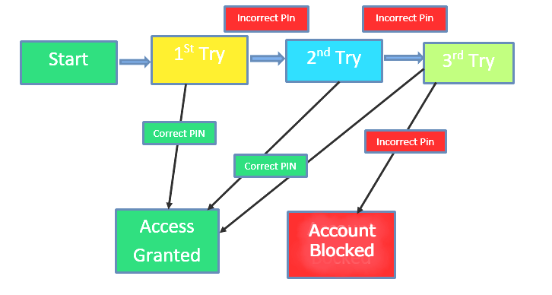
State Transition Model
Benefits:
Helps uncover missing or incorrect transitions.
Effective in validating system behavior under different conditions.
Current State | Event | Next State | Action
Logged Out | Login | Logged In | Display Home
Logged In | Logout | Logged Out | Display Login
Logged In | Session Timeout | Logged Out | Display Login
JTG Company Confidential

Slide 13
Decision Tables
Definition: A decision table is a tabular method used for representing and analyzing conditions and actions in testing scenarios. It helps outline all possible combinations of inputs and their corresponding expected outputs.
Purpose:
Ensure all business rules and test conditions are captured.
Simplify complex logical decisions by structuring them into manageable tables.
Provides a comprehensive set of test cases.
Key Elements:
Conditions: The different input combinations or decision factors.
Actions: The expected output or result based on conditions.
Rules: A set of conditions mapped to specific actions.
JTG Company Confidential

Slide 14
Decision Tables
When to Use:
Systems with complex business logic.
Testing multiple combinations of inputs.
How to Create a Decision Table?
Identify Conditions:
List all conditions (inputs) that affect the decision.
Identify Actions:
Determine the actions (outputs) that should result from the combination of conditions.
Create Decision Rules:
For each combination of conditions, define the corresponding actions.
JTG Company Confidential

Slide 15
Decision Tables
Fill in the Table:
Populate the table with all possible combinations of conditions and their expected actions.
Example:
Benefits:
Clear understanding of all condition-action combinations.
Reduces ambiguity in complex logic testing.
Conditions | Rule 1 | Rule 2 | Rule 3 | Rule 4
Condition 1(True/False) | T | T | F | F
Condition 2(True/False) | T | F | T | F
Action | Action 1 | Action 2 | Action 3 | Action 4
JTG Company Confidential

Slide 16
Use cases
It is created to show how a system intends to work.
It also explains how users might apply it instead.
It is written before test cases and can be explained as a blueprint or template for test cases.
Example: Use cases for a flight booking system.
A customer browsing flight schedules and prices
A customer selecting a flight date and time
A customer adding on lounge access and free checked bags
A customer paying with a personal credit card
JTG Company Confidential

Slide 17
Reference Links
https://www.geeksforgeeks.org/software-testing-techniques/
https://www.guru99.com/software-testing-techniques.html
https://artoftesting.com/boundary-value-analysis
https://www.geeksforgeeks.org/equivalence-partitioning-method/
https://www.guru99.com/state-transition-testing.html
https://www.techtarget.com/searchsoftwarequality/definition/use-case
https://study.com/academy/lesson/what-is-a-use-case-definition-examples.html
https://www.guru99.com/decision-table-testing.html
JTG Company Confidential

Slide 18

THANK YOU
www.joshtechnologygroup.com
Tuesday, 5 February 2019
JTG Company Confidential

